Slide 1
Welcome to AP World History Mrs. Hatlen

Slide 2
My Check List for Every Class
Keep them safe
Lower their anxiety about the current situation
Make them laugh
Let them know I care about them
Teach them something
In this order

Slide 3
About Me
Proud Lion!
Year 8 at Liberty High School
Courses taught:
AP World History
World History
Government
Economics
AP Seminar
AP Research

Slide 4
Contact Information
hatlenm@luhsd.net
Liberty High School Website teacher page- Melissa Hatlen

Slide 5
Why Take AP World?
Stand out in College Admissions- Admissions officers know the student has experienced college level course
Possibly Earn College Credits- Colleges may offer college credit, advanced placement, for AP Exam scores
Build College Skills- AP courses prepare students for next phase of educational journey
Earn High School Grade Bump: Students who earn an A, B, or C in class will earn a one letter grade bump towards their high school GPA

Slide 6
MyAP Account
In order to register to take the AP Test, students must:
Register for each AP course on myap.collegeboard.org. Students should receive join codes from AP teacher
This registration will also grant students with free test practice and lessons ☺
If you think you may qualify for a discounted test, please submit a request for a Fee Reduction
You will be contacted directly by phone or email if you qualify.

Slide 7
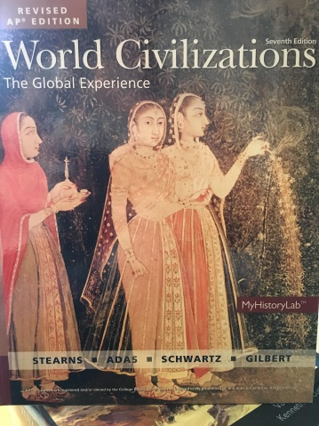
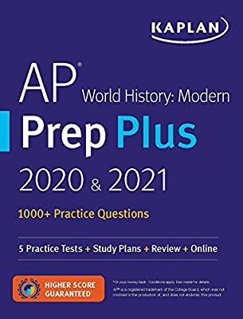
AP World History Exam
Exam date: May 12, 2022
Content will cover developments from 1200-present
Section 1A: Multiple Choice
Section 1B: Short Answer Questions
Section 2A: Document Based Question (Essay)
Section 2B: Long Essay
I also recommend review books ☺

Slide 8
Period Number | Title | Time Frame | Period Weights | Textbook Chapters
Period 1 | Regional and Interregional Interactions | 1200 C.E. -1450 C.E. | 16%-20% | 7-16
Period 2 | Global Interactions | 1450 C.E. -1750 C.E. | 24%-30% | 17-23
Period 3 | Industrialization and Global Integration | 1750 - 1900 | 24%-30% | 24-28
Period 4 | Accelerating Global Change and Realignments | 1900 – Present | 24%-30% | 28-37

Slide 9
Historical Thinking Skills
70% of the AP exam will require students to analyze primary source documents, maps, diagrams, etc.
Simply put…it is NOT about memorization!!!!
These skills include
Cause and Effect
Continuity and Change
Periodization
Compare and Contrast
Historical Argumentation
Support with Appropriate Evidence
Identify Author or Source Bias

Slide 10
Assignments
All assignments will be posted on Canvas
Use Canvas for
Calendar w/ upcoming events, assignments, tests
Homework assignments
Online discussions
Quizzes & tests
Grades

Slide 11
Assessments
Because we are preparing students for the AP Exam, students will practice taking these exams
We will have unit tests that will model the AP Exam
We will also have some quizzes in between
For writing assessments, I offer a makeup before the next assessment

Slide 12
My Check List for Every Class
Keep them safe
Lower their anxiety about the current situation
Make them laugh
Let them know I care about them
Teach them something
In this order
If I am not meeting any portion of this checklist, please reach out to me at hatlenm@luhsd.net

